Slide 1



The Sacramento Environmental Justice Coalition
La Coalición de Justicia Ambiental de Sacramento
Notes:
Reading material, Disclaimer about organizing (challenge about yourself, identify and self map to use it for building power to help those who have no status, no assets, no recognition, this is the.) If you believe this is the place to learn how to motivate others to do your will…leave now. Go to one of those Wall Street billionaires motivation speakers.

Slide 2



https://www.epa.gov/environmentaljustice/learn-about-environmental-justice
Environmental justice (EJ) is the fair treatment and meaningful involvement of all people regardless of race, color, national origin, or income with respect to the development, implementation and enforcement of environmental laws, regulations and policies.
La justicia ambiental (JM) es el trato justo y la participación significativa de todas las personas, no importa su raza, color, origen nacional o ingresos, con respecto al desarrollo, implementación y cumplimiento de las leyes, regulaciones y políticas ambientales.
https://drrobertbullard.com/
Notes:
Reading material, Disclaimer about organizing (challenge about yourself, identify and self map to use it for building power to help those who have no status, no assets, no recognition, this is the.) If you believe this is the place to learn how to motivate others to do your will…leave now. Go to one of those Wall Street billionaires motivation speakers.

Slide 3
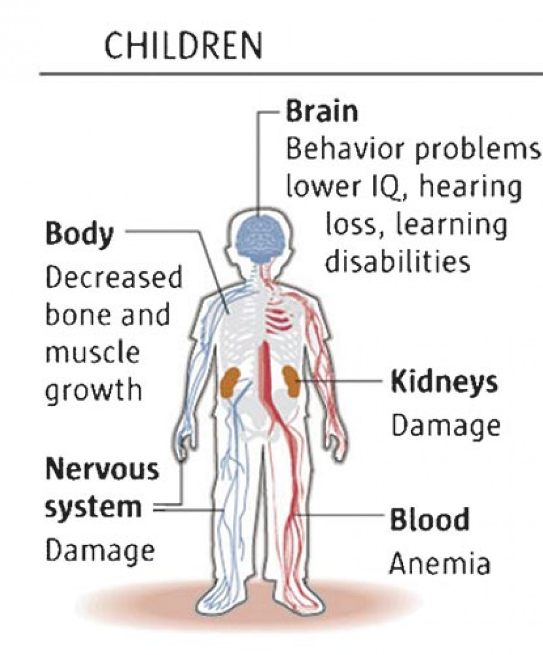
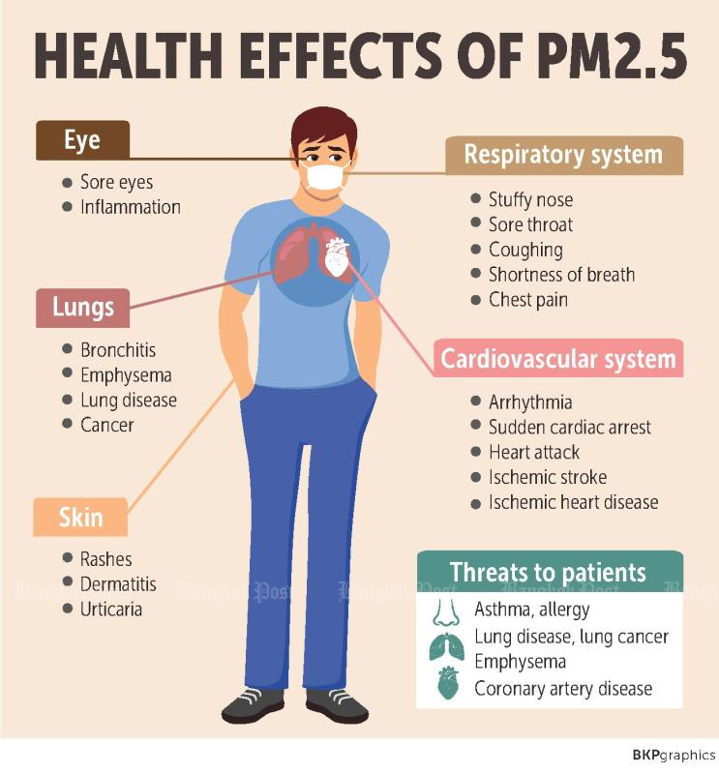
Lead Poisoning
Notes:
Chronic exposure to air pollution has long been linked with cardiopulmonary-related mortality, and ambient fine particulate matter (PM_{2.5}) is often considered a primary cause of this association. Once inhaled, these particles can cause inflammation and oxidative stress. This in turn may result in systemic effects, including the buildup of plaque deposits that can lead to heart attacks and strokes. (National Institute of Health/ US National Library of Medicine)
https://www.ncbi.nlm.nih.gov/pmc/articles/PMC2854789/#:~:text=Ambient%20PM2.5%20contains%20solid,potassium%2C%20silicon%2C%20and%20zinc.

Slide 4
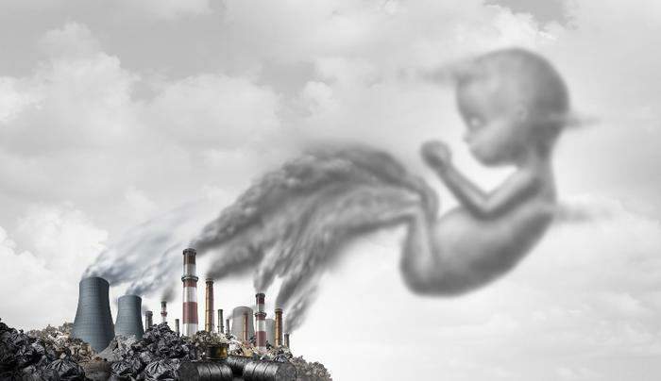
Pollution and Pregnancy
Contaminación y el Embarazo
Higher Risk of: Corren un mayor riesgo de:
Pre-term Birth Parto prematuro
Low Birth weight Bajo peso al nacer
Obesity Obesidad
High Blood Pressure Alta presión
Still Births Nacimientos muertos
Miscarriage Aborto espontáneo
Autism risks Riesgo de Autismo
Sources / Fuentes:
https://www.consumeraffairs.com/news/exposure-to-air-pollution-in-utero-may-increase-the-risk-for-asthma-in-preschoolers-study-finds-052421.html
https://www.ncbi.nlm.nih.gov/pmc/articles/PMC3527658/
https://www.cnn.com/2018/11/19/health/air-pollution-autism-vancouver-study
https://www.lung.org/clean-air/outdoors/who-is-at-risk/children-and-air-pollution
https://www.cdc.gov/nceh/lead/prevention/pregnant.htm
Notes:
Chronic exposure to air pollution has long been linked with cardiopulmonary-related mortality, and ambient fine particulate matter (PM_{2.5}) is often considered a primary cause of this association. Once inhaled, these particles can cause inflammation and oxidative stress. This in turn may result in systemic effects, including the buildup of plaque deposits that can lead to heart attacks and strokes. (National Institute of Health/ US National Library of Medicine)
https://www.ncbi.nlm.nih.gov/pmc/articles/PMC2854789/#:~:text=Ambient%20PM2.5%20contains%20solid,potassium%2C%20silicon%2C%20and%20zinc.

Slide 5
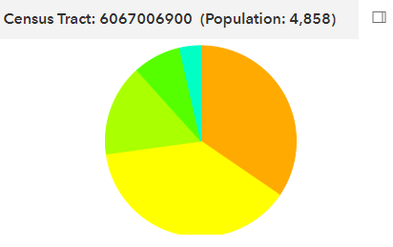
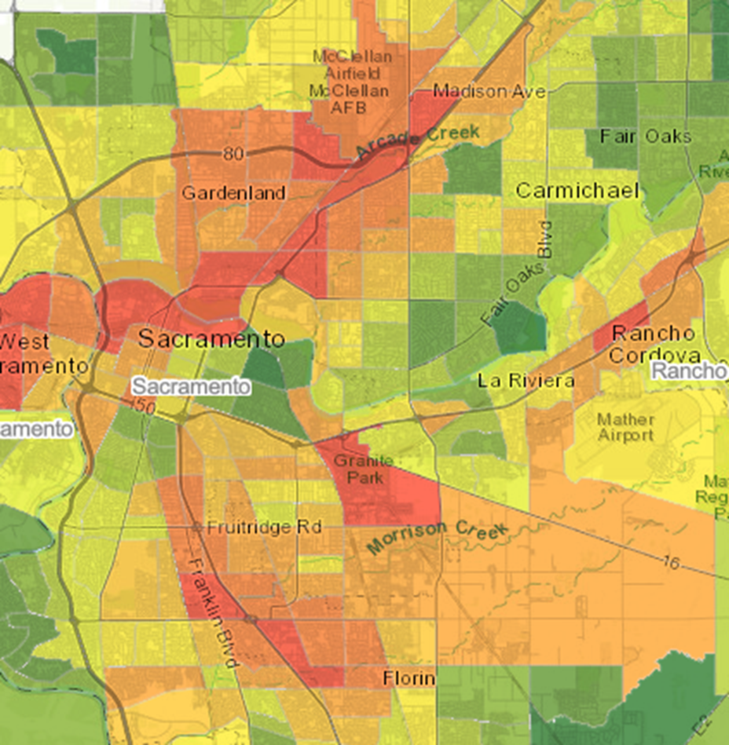
Environmental Justice Zones
Asian American
8.1%
African American 15.5%
Latino 34.5%
White 38.3%
Percentile
Asthma / Asma 100
Low Birth Weight / bajo peso al nacer 76
Cardiovascular Disease / Enfermedad cardiovascular 97
Pollution / Contaminacion
Ozone 51
Particulate Matter 2.5 38
Diesel Particulate Matter 70
Toxic Releases 29
Traffic 32
Pesticides 0
Drinking Water 17
Lead from Housing 79
Cleanup Sites 87
Groundwater Threats 94
Hazardous Waste 80
Impaired Waters 77
Solid Waste 22
Source: https://oehha.ca.gov/calenviroscreen/report/calenviroscreen-30

Slide 6
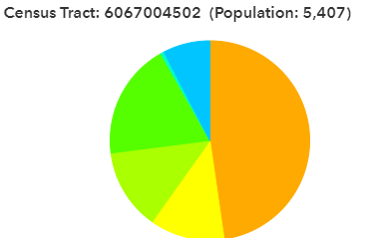
Environmental Justice Zones
Asian American
18.8%
Latino 47.7%
African American 13.1%
White 12.1%
Percentile
Ozone 40
Particulate Matter 2.5 35
Diesel Particulate Matter 80
Toxic Releases 32
Traffic 91
Pesticides 0
Drinking Water 85
Lead from Housing 69
Cleanup Sites 10
Groundwater Threats 60
Hazardous Waste 66
Impaired Waters 44
Solid Waste 0
Asthma 98
Low Birth Weight 92
Cardiovascular Disease 99
Source: https://oehha.ca.gov/calenviroscreen/report/calenviroscreen-30

Slide 7
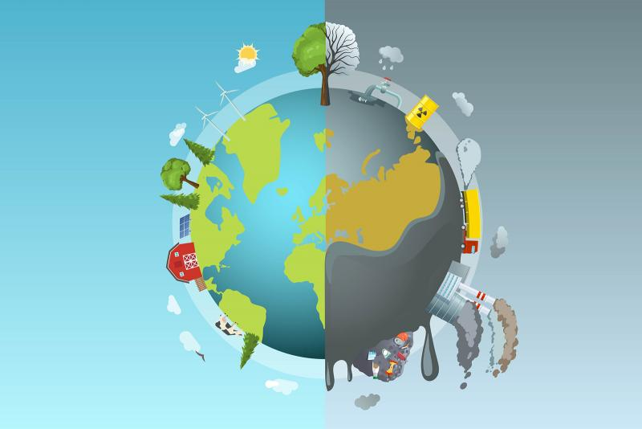

Slide 8
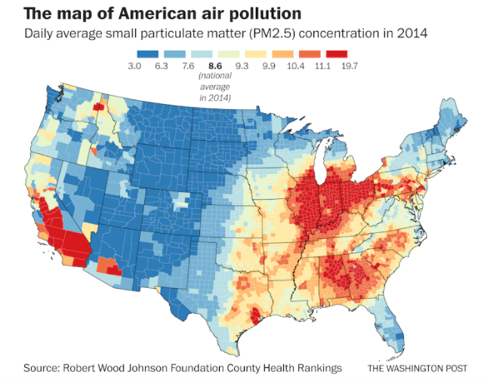

Slide 9
Laudato Si
On Care for Our Common Home
Cuidando Nuestra Casa Común
CARE FOR GOD’S CREATION
CUIDANDO LA CREACIÓN DE DIOS
A MORAL AND SPIRITUAL CHALLENGE
UN DESAFÍO ESPIRITUAL Y MORAL
Rebuild our connection with Earth, God, and Each other
Reconstruir nuestra conexión con la Tierra, Dios, y uno al otro
IMPACT ON THE POOR
EL IMPACTO CON LOS POBRES
CALLED TO SOLIDARITY
UN LLAMADO A LA SOLIDARIDAD
Create
HOPE AND JOY
Crear
La Esperanza y Alegria
TECHNOLOGICAL AND ECONOMIC DEVELOPMENT IMPACT ON THE PLANET
DESARROLLO TECHNOLOGICO Y ECONOMICO Y SU IMPACTO EN EL PLANETA
SUPPORTING LIFE, PROTECTING CREATION
PROTECCION A LA VIDA Y LA CREACION
A TIME TO ACT
Pope Francis calls for a change in lifestyle and consumption. We can make important changes as individuals, families, and communities, and as civil and political leaders.
El Papa Francisco nos llama a cambiar nuestro estilo de vida y consumo. Podemos hacer cambios importantes como individuos, familias, y comunidades y como lideres civicos y politicos.
https://www.sandiego.edu/francis/laudato-si/major-themes.php (used at parishes)
Notes:
https://www.sandiego.edu/francis/laudato-si/major-themes.php
Use the worksheet / uso de ejercicio de lectura

Slide 10
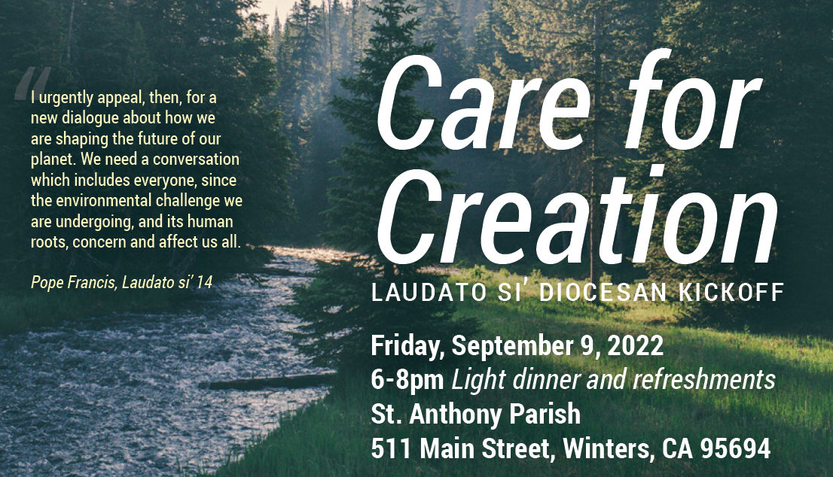

Slide 11
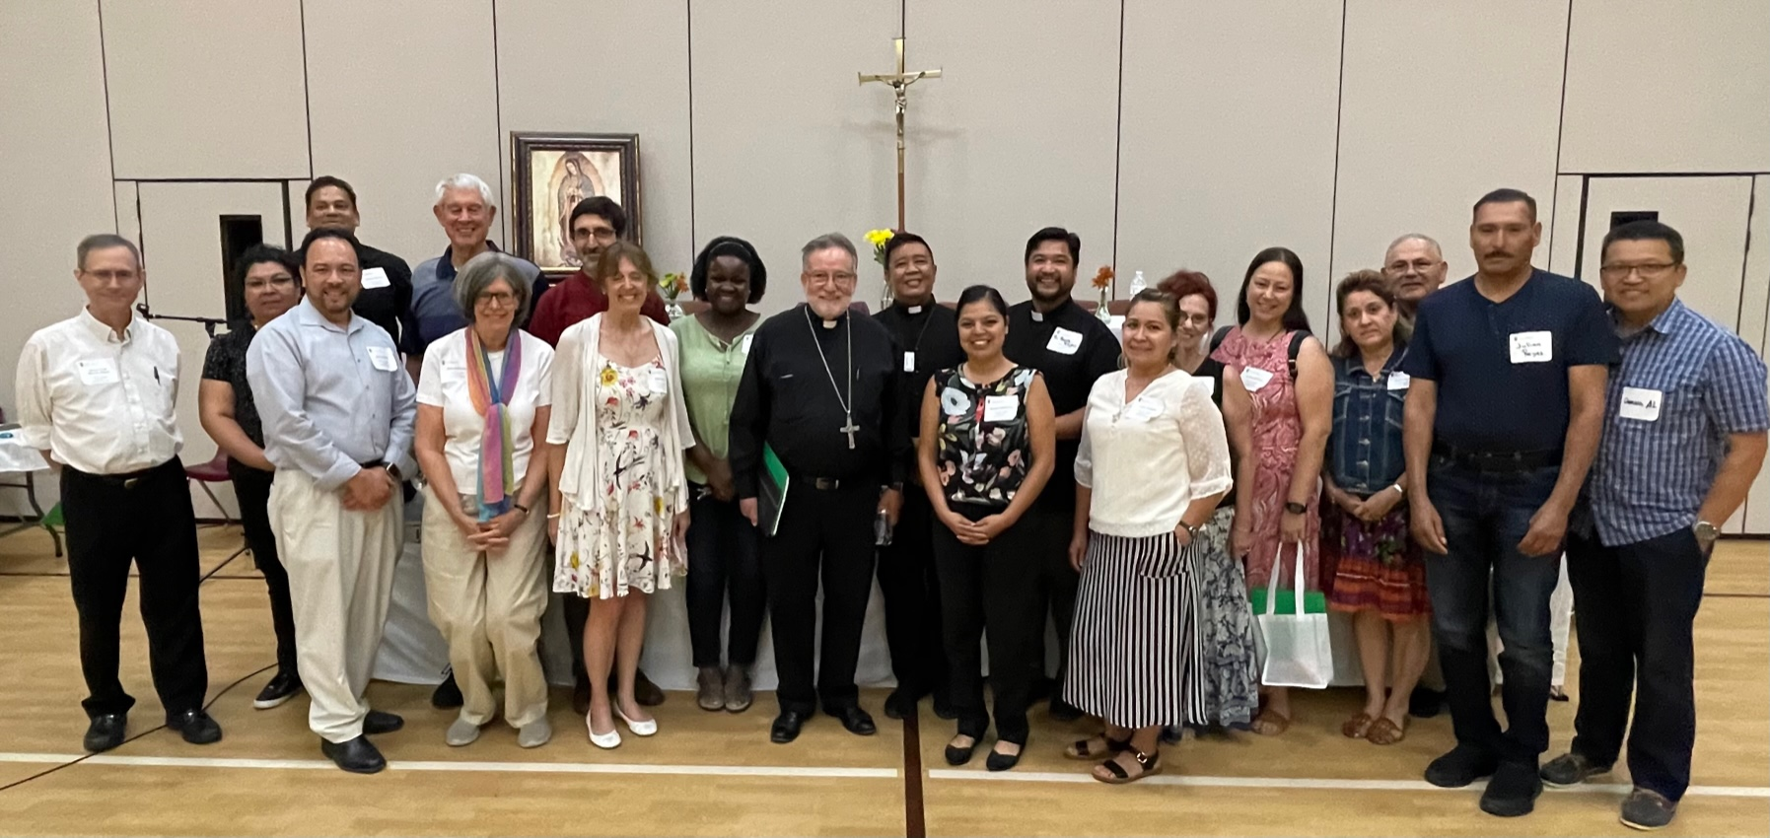

Slide 12
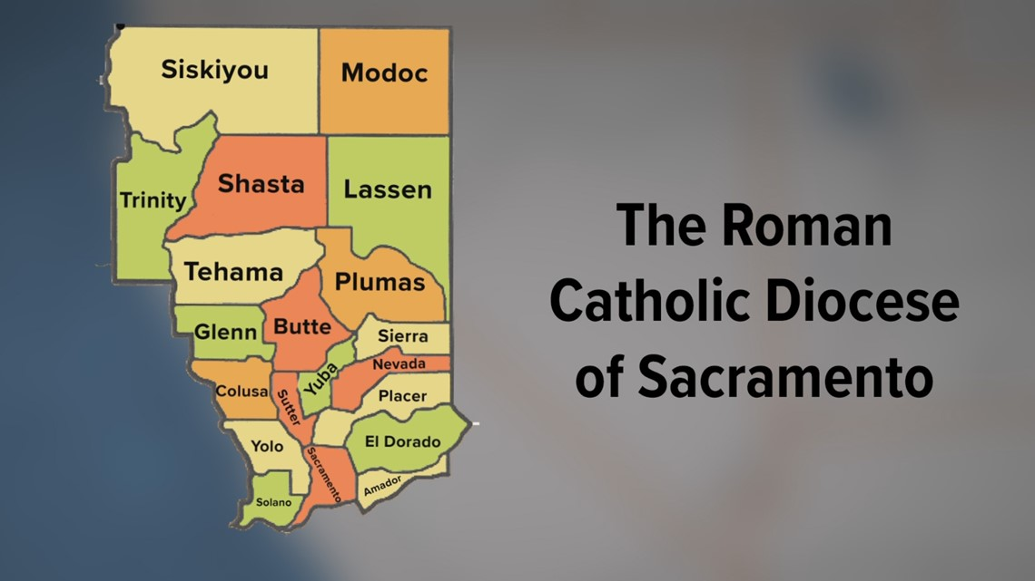
Total Population per County
Siskiyou 44,076
Modoc 9,686
Trinity 16,112
Shasta 182,155
Lassen 32,730
Tehama 65,829
Plumas 19,790
Glenn 28,917
Butte 211,632
Sierra 3,236
Colusa 21,839
Sutter 99,633
Yuba 81,575
Nevada 102,241
Yolo 216,403
Placer 404,739
Solano 453,491
Sacramento 1,585,055
El Dorado 191,185
Amador 40,474
Total Population: 3,628,643

Slide 13
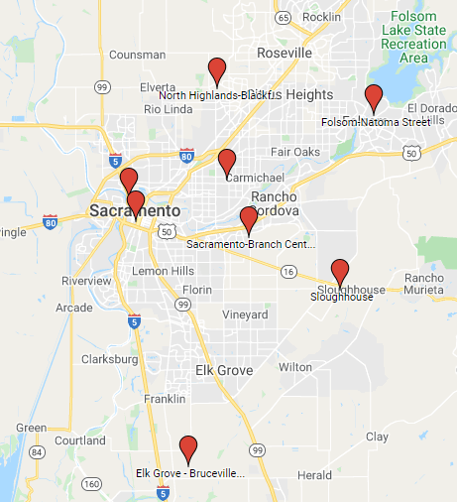

Federal Air Quality Monitors in Sacramento
Monitores Federales detectan violaciones de la leyes de la calidad del aire (US EPA)
Miden los niveles de contaminación para dar datos al gobierno para reducir/mitigar problemas
¿Por que no hay monitores de aire Federal en el Sur de Sacramento?
Federal Monitors Trigger Enforcement if there are violations of the Clean Air Act (US EPA)
They gather specific data to help regulators reduce/mitigate pollution
Why are there no Federal Air Quality Monitors in Sacramento?
Source: Sacramento AQMD

Slide 14
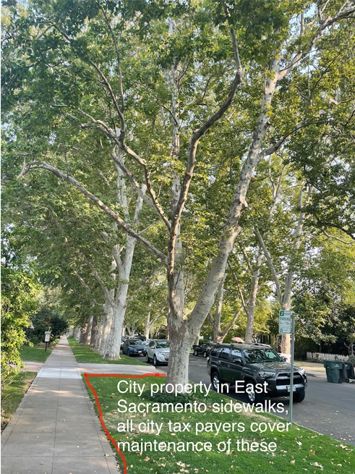
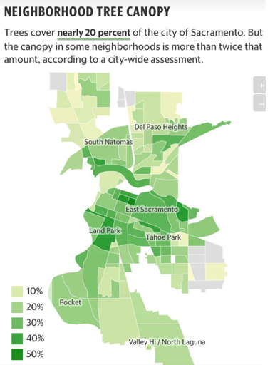
Source: SacEJC Research and City of Sacramento Planning Dept
Source: https://www.sacbee.com/

Slide 15
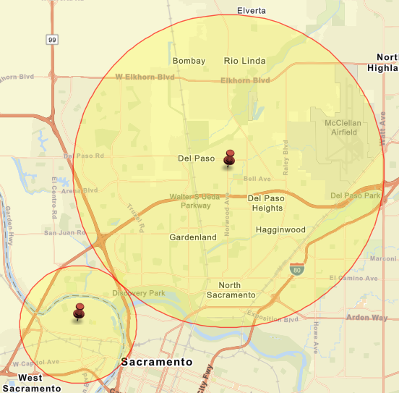
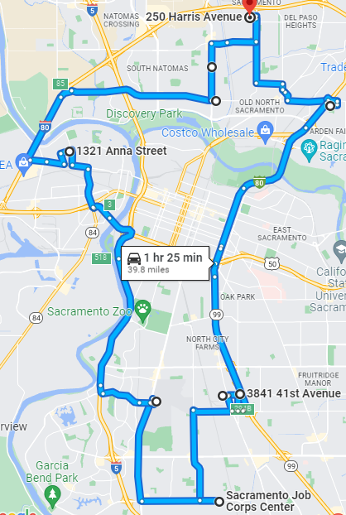
The EJ Tour of Sacramento

Slide 16
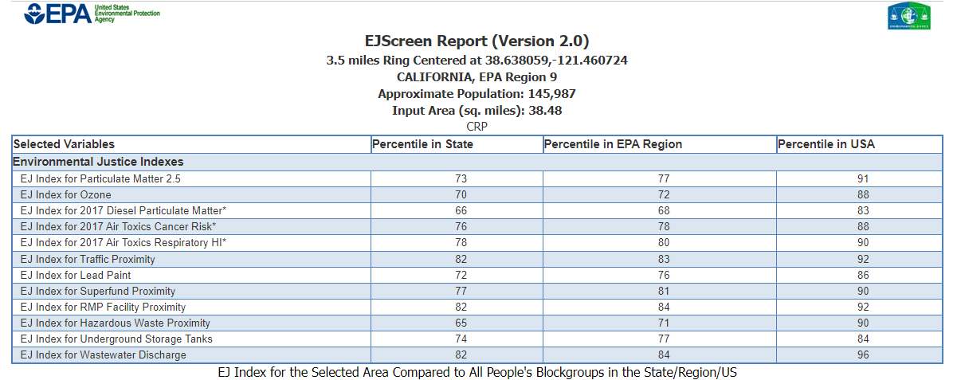
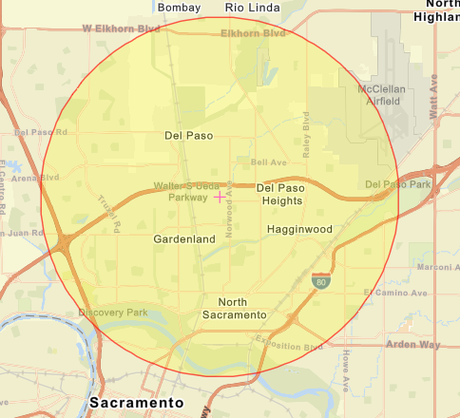

Slide 17
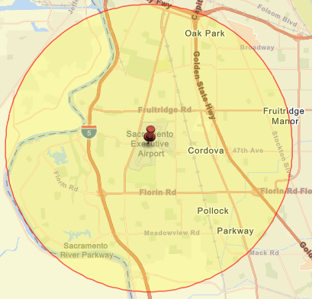
The EJ Tour of Sacramento

Slide 18
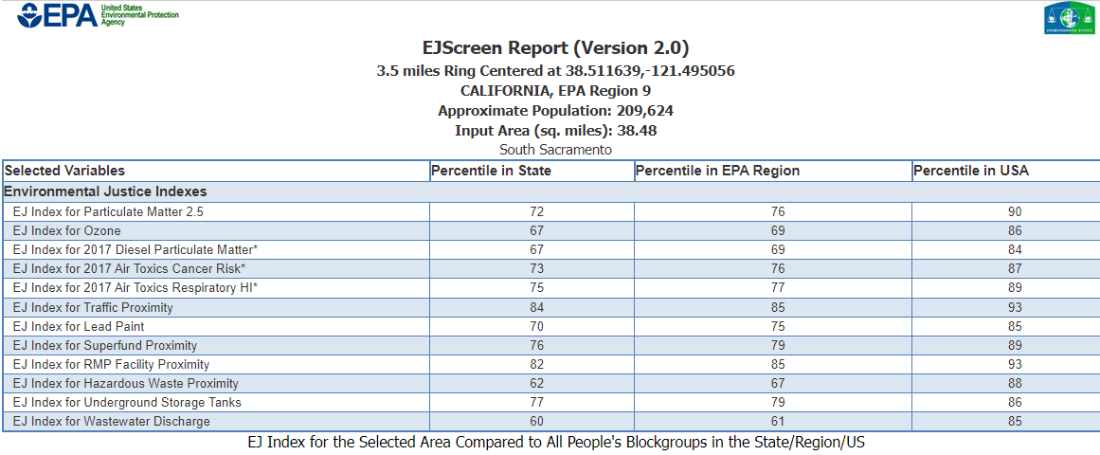


Slide 19
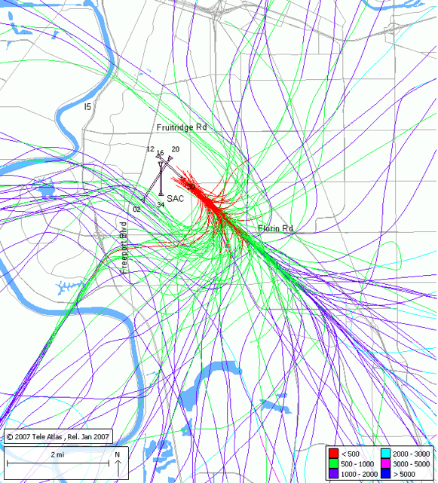
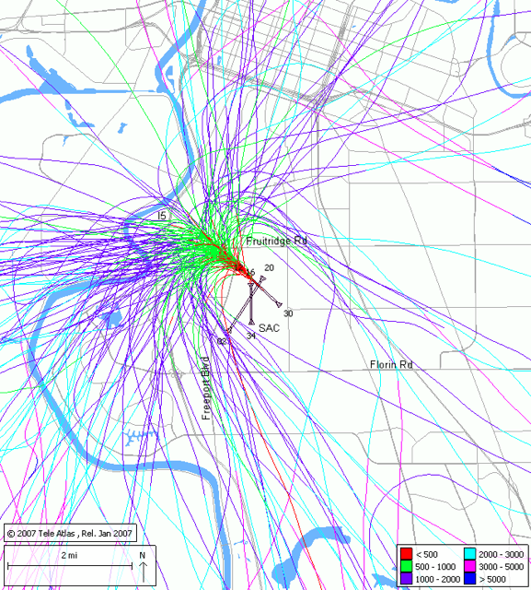
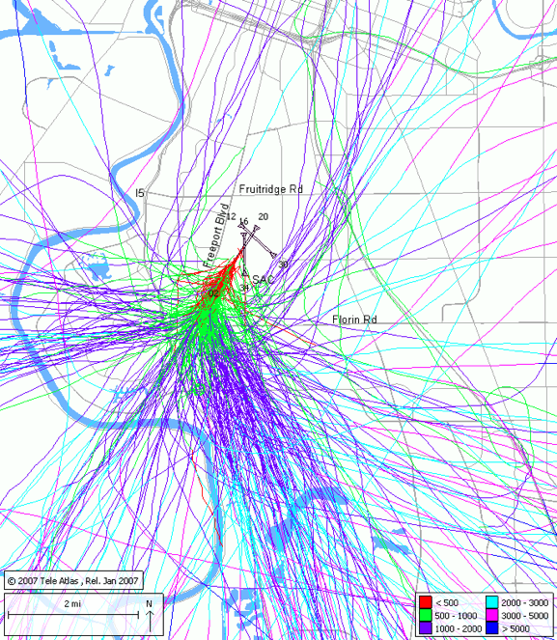
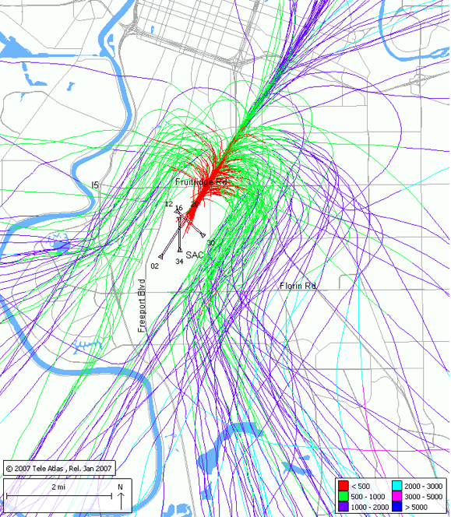
Executive Airport Departures and Arrival Flight Paths- Lead Fuel Airplanes

Slide 20
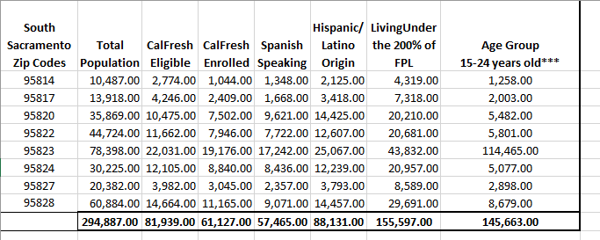
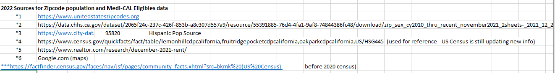
South Sacramento Zip Codes

Slide 21
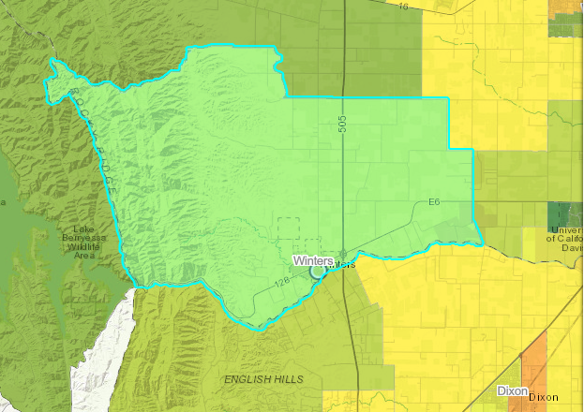
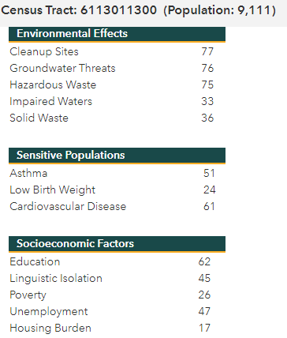
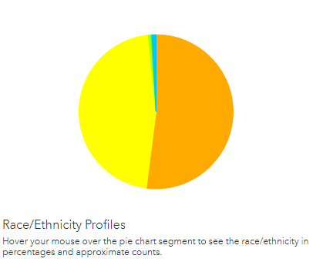
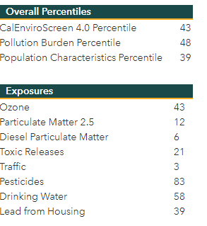
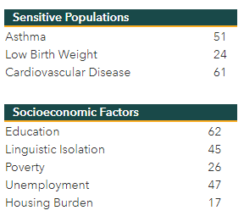
Winters EJ Concerns
.6% African American
.6% Other
46.4% White
52% Hispanic
Source: https://oehha.ca.gov/calenviroscreen/report/calenviroscreen-30

Slide 22


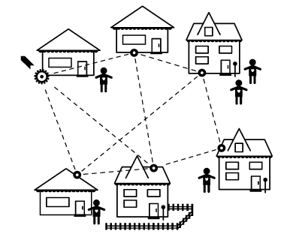



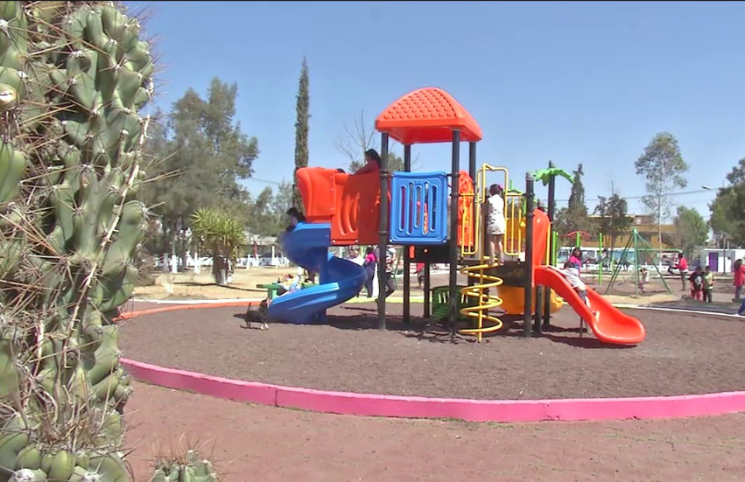
Map of community / Mapa del barrio
To take action / Para tomar acción
Neighbors and Associations
Vecinos y asociaciones
Community Centers / Parks / Centros Comunitarios Parques
Comerciantes Justos

Slide 23


Thank you! Muchas Gracias!
“...We have to realize that a true ecological approach always becomes a social approach; it must integrate questions of justice in debates on the environment, so as to hear both the cry of the earth and the cry of the poor.”
"... Tenemos que darnos cuenta de que un verdadero enfoque ecológico siempre se convierte en un enfoque social; debe integrar las cuestiones de justicia en los debates sobre el medio ambiente, a fin de escuchar tanto el grito de la tierra como el grito de los pobres".
- Pope Francis
Laudato Si
Herman Barahona Sign our petition to ban lead-fuel!
barahonaconsulting@gmail.com
916-900-1717

